Slide 1
Driver Drowsiness Detection System
Human Computer Interaction
Submitted By
Submitted To
Name | ID
Sadir Ahmed Zidan | 20-43263-1
Md. Sahilur Rahman | 20-43257-1
Sajjad Hossain Shakib | 20-43842-2
S.M. Adnan Mahmud | 20-43507-1
Dr. Muhammad Firoz Mridha
Associate Professor
Computer Science

Slide 2
Outline
Introduction
Objectives
Contribution
Data Collection
Model Architecture
Proposed Method Using Hardware
Existing Work
Components
Hardware
Software
Prototype Design
Block Diagram
Circuit Diagram
Final Model
Features
Advantages
Future Works
Conclusion

Slide 3

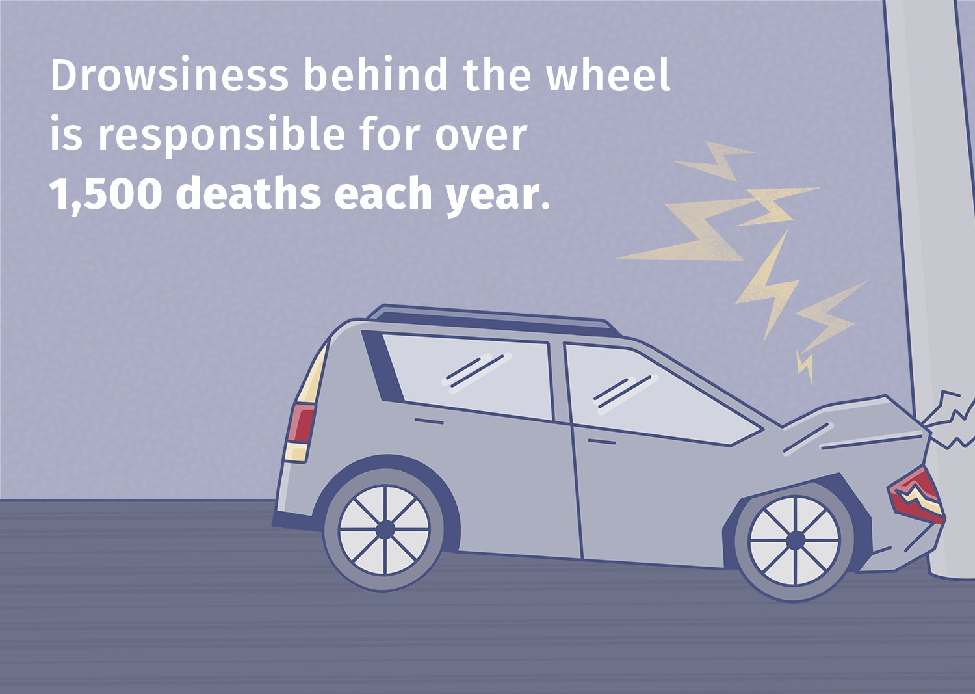
Introduction
Drowsiness is a state of extreme tiredness and sleepiness, leading to reduced alertness and impaired cognitive and physical functions. It poses risks such as decreased attention, slower reactions, and impaired decision-making, particularly hazardous during activities like driving.
Drowsy driving is a major contributor to global traffic accidents, causing significant fatalities and injuries. In the USA, approximately 100,000 crashes, 71,000 injuries, and 1,550 deaths annually are attributed to drowsy driving.
Facial feature-based methods offer a cost-effective and non-invasive solution for real-time drowsiness detection.

Slide 4
Objectives
To develop a deep learning model based on the Mobile Net architecture that can classify between open and closed eyes for the purpose of detecting drowsiness in drivers.
To detect driver drowsiness using facial features such as eye state with the help of computer vision, image processing and machine learning.
To predict the eye state and based on the result of eye state the Arduino based alert system will show the output and alert the driver and passengers.
To explore the feasibility of real-time drowsiness detection.

Slide 5
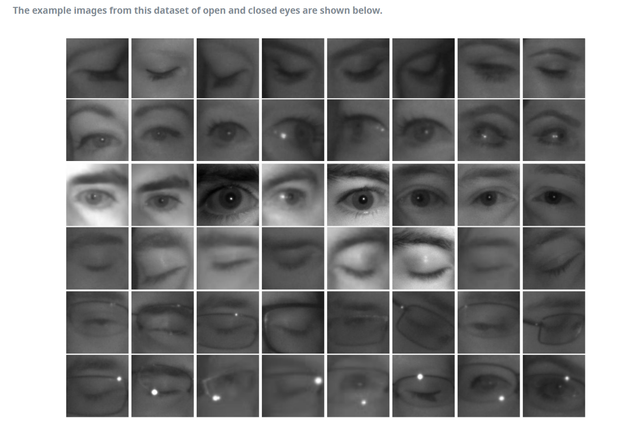
Data Collection
In order to train our machine learning CNN model, we need to choose a dataset with enough numbers of data. In this project, MRL eye dataset will be used. This dataset has an extensive collection of images of human eyes. This dataset includes low and high-resolution infrared photos that were all taken under varied lightning situations and with various equipment. Testing various features or trainable classifiers is appropriate for this dataset. This dataset is consisting images of 37 candidates, among them 33 men and 4 women. All the images are open eyes or closed eyes image. There are total number of 84,898 images of close and open eyes. We will split the data 80% for training and validation other 20% for testing and evaluating the model.
Dataset Link: MRL Eye Dataset | MRL (vsb.cz)

Slide 6
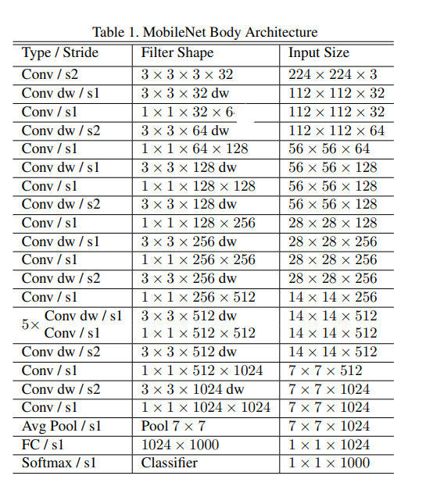
Model Architecture
MobileNet Model will be used for classification of closed eyes and open eyes. This model is widely used for image classification as it performed well on the Image dataset.
In the 1st step: The datasets will be prepared then the CNN Model will be built based on the problem. After that, the CNN model will be trained on the prepared Dataset.

Slide 7
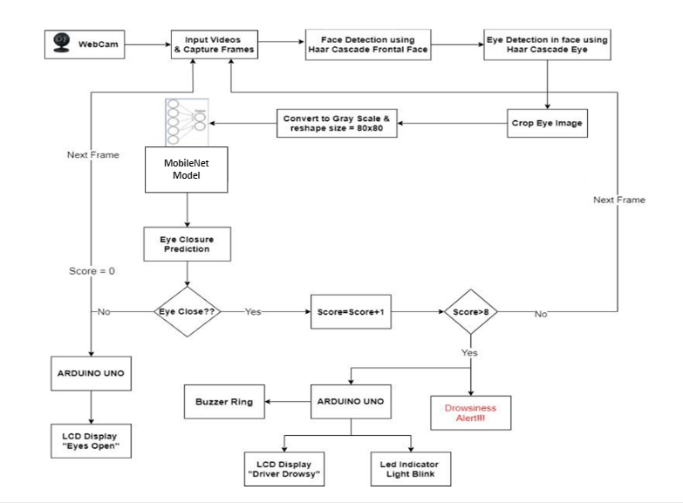
Contribution
Proposed Method Using Hardware
In the 2nd step: Realtime detection will be done using OpenCV computer vision library. Haar Cascade classifier detects the face and eyes After the eyes detected it cropped the eye image and convert the image from RGB to Gray Scale. Then the MobileNet trained model detects the eye state, if eye is close the calculated value is near 0 and if it is open then the value is near 1.
The pyserial library sent the results to the Arduino board using serial communication and the exported Arduino program in the Arduino board shows the output based on the calculated results. If the result shows close eyes, it will calculate a score where score=score+1, if it is open eyes the score=0. Once the score crosses the threshold, it will alert drowsiness. The threshold is basically the serial number of frames where the eyes are closed.

Slide 8
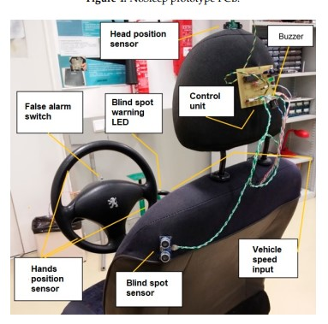
Existing Work
Capacitive sensor sowed inside steering wheel Whenever the driver has one or both hands on the steering wheel, the capacity value will change.
Vehicle driving sensors, on-board diagnostics connector & ultrasound sensor for outside obstacle detection. .
Fig: NoSleep prototype lab demonstration
[Meireles, T., & Dantas, F. (2019). A low-cost prototype for driver fatigue detection. Multimodal Technologies and Interaction, 3(1), 5.]

Slide 9
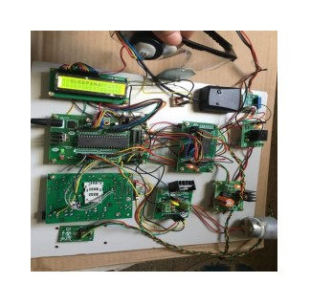
Existing Work
Sensors collect data like driver's eye blink rate, vehicle speed, and shock/vibration from accidents.
Microcontroller receives inputs and sends signals to output ports for necessary actions.
GSM module alerts vehicle owner and offers options like location, photos, and details via email.
Warning messages caused by driver drowsiness are shown on the LCD screen.
Fig: Driver Drowsiness Detection System Using Sensors
[Kumari, B. M., Sethi, S., Kumar, P. R., Kumar, N., & Shankar, A. (2018). Driver Drowsiness Detection System Using Sensors. Journal of Computational and Theoretical Nanoscience, 15(11-12), 3261-3265.]

Slide 10
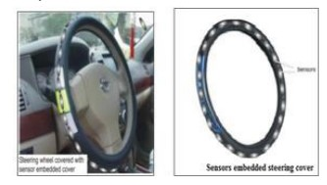
Existing Work
This module consists of an array of IR sensors embedded in the steering wheel. When the driver's palm obstructs the emitted IR light, the reflected light is captured to analyze heart rate variability, which depends on blood volume changes in blood vessels.
This module stores the collected sensor data for further analysis.
Responsible for processing and analyzing the sensor data to determine driver drowsiness. Real-time monitoring and feedback are provided to the driver.
Fig: Sensor Embedded Steering Wheel
[Thomas, B., & Gupta, A. (2012). Wireless sensor embedded steering wheel for real time monitoring of driver fatigue detection. UACEE International Journal of Advances in Computer Networks and Its Security, 2(1), 66-69.]

Slide 11
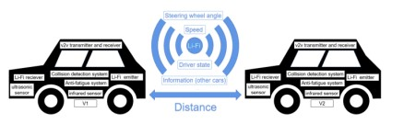
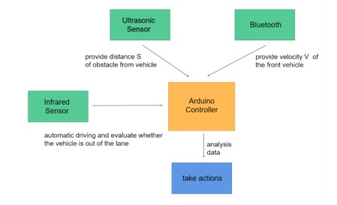
Existing Work
AFDS uses AFDT in four stages: A analyzes eye data for fatigue, B evaluates turn signals for safety, C assesses steering wheel and lane data, and D triggers alarms and responses based on AFDT's findings.
AFDS responds differently based on AFDT results. "Normal" prompts reminders, "Moderate" engages additional sensors, and "Critical" triggers emergency measures like lane correction and warnings.
Li-Fi tech enhances collision avoidance (ECAS) by connecting vehicles via transmitters and receivers, creating a reliable moving LAN for communication.
Li-Fi augments V2V communication, overcoming signal challenges in cellular dead zones and congested urban areas.
Fig: Intelligent Vehicles with Ultrasonic and Li-Fi Sensors
[Li, Y. (2020). Anti-Fatigue and Collision Avoidance Systems for Intelligent Vehicles with Ultrasonic and Li-Fi Sensors. 2020 IEEE 3rd International Conference on Information Communication and Signal Processing (ICICSP).]

Slide 12
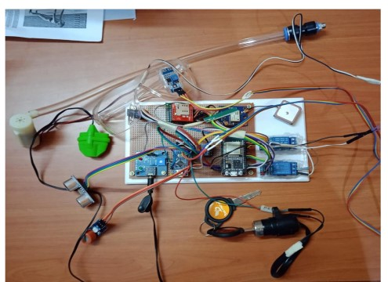
Existing Work
System employs two microcontrollers, Arduino Nano and ESP32, synergizing their capabilities. Arduino Nano manages pulse, alcohol, and obstacle sensors, while ESP32 handles GPS, GSM, and the water sprinkler. This dual-controller setup optimizes safety by merging local control with cloud connectivity.
The system implements a multi-tiered approach to detect driver drowsiness. An eye-blink sensor on goggles identifies closed eyes, triggering a buzzer warning. Persistent drowsiness activates a water sprinkler for heightened alertness. This layered strategy minimizes the risk of accidents due to driver fatigue.
Fig; Smart Alerting System
[https://www.ijraset.com/research-paper/iot-based-driver-drowsiness-detection-and-smart-alerting-system#references]

Slide 13
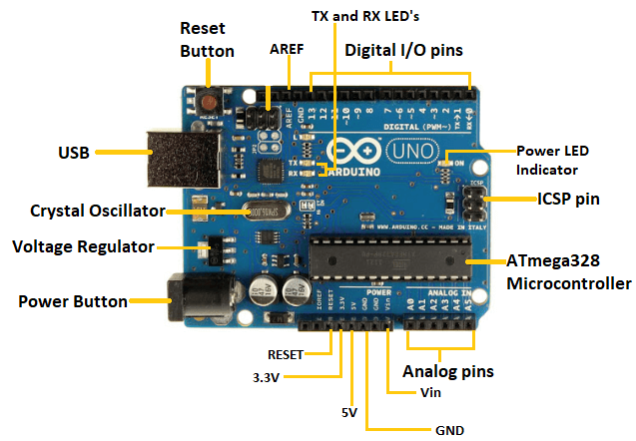

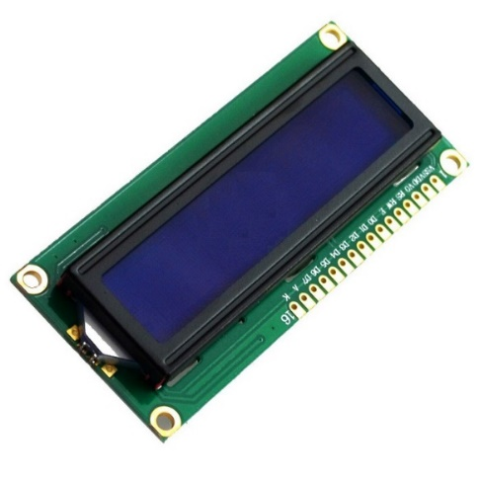
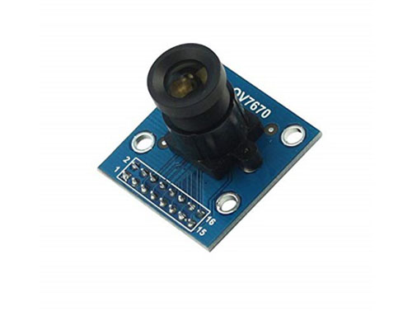
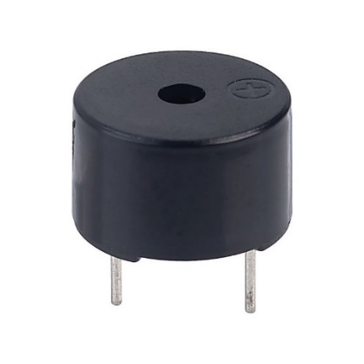
Components
Hardware
Arduino Uno
Camera
Wires
Buzzer
Display
LED

Slide 14




Components
Software & Tools
Arduino IDE
VS Code
Microsoft Visio
Jupyter Notebook

Slide 15
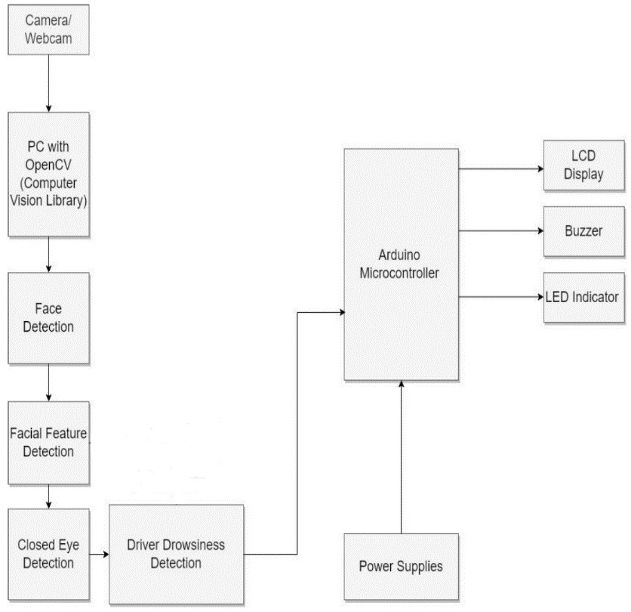
Prototype Design
Block Diagram
The block diagram showing in schematic form, the general arrangement of the parts or components of our proposed system or process. Where it shows the process from starting to end of the drowsiness detection system. Here the camera takes live picture frames and it’ll be then processed through our model which will be included in Arduino. According to the result, the system will give outputs with the help of Arduino microcontroller and other devices.

Slide 16
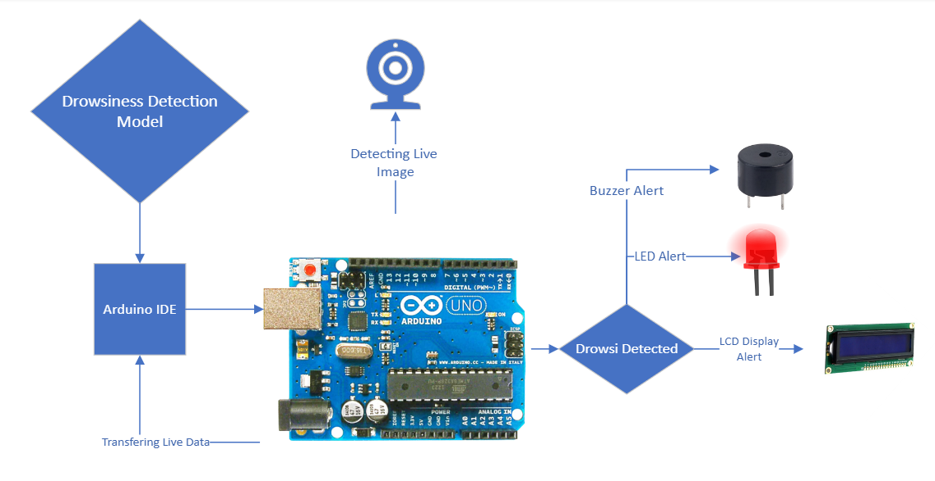
Prototype Design
Circuit Diagram
This is the circuit diagram, which shows a simplified graphical representation of the electrical circuit of our project. This is used for the idea of design, construction and maintenance of electrical and electronic equipment of the project.

Slide 17
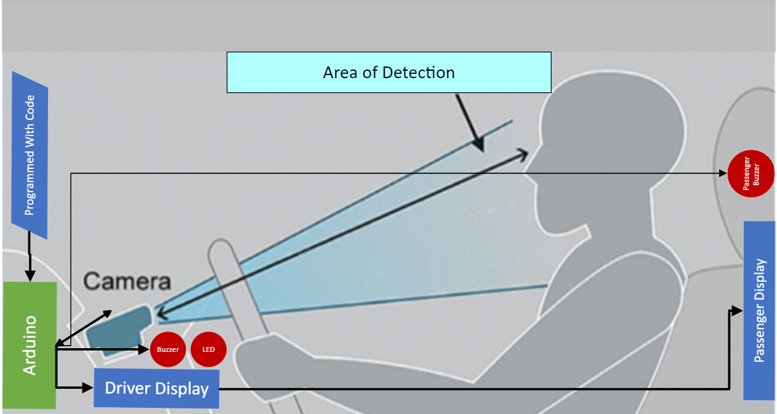
Prototype Design
Final Model
Notes:
Here is our final model , which we are proposing to build after hardware and software setup. Our design offers a camera on the dashboard behind the stearing and in a place from where the eyes of the driver will be clearly visible. Inside the dashboard there will be an Arduino which will be programmed with machine learning code. Through the program , the Arduino will receive pictures frame and it will process through the program. And the result will be shown in the driver and passenger display. While the frame will show continuous close eyes, the display will show eyes closed in both displays and the buzzer will turn on for both driver and passenger. Also the led will be blinking..

Slide 18
In two or three columns
Features
Driver Drowsiness detection system using facial feature-based approach.
Drowsiness detection in the most accurate and less expensive way.
Getting alert on live data.
Alert through buzzer.
Alert through LED.
Alert through LCD display.
Alert for both driver and passengers.

Slide 19
Advantages
Enhanced Road Safety
Accurate Drowsiness Detection
Low-Cost Implementation
Real-time Monitoring
Automatic Alerts
Non-Invasive Approach

Slide 20
Future Work
Enhanced Model Training
More Personalization
Multimodal Approaches
Cloud Connectivity
Data Privacy and Ethics
Sensitivity to Different Races and Genders

Slide 21
You can also split your content
Conclusion
The proposed drowsiness detection system combines image processing, machine learning, and hardware components to accurately detect drowsy driving in real-time, using technologies like the MobileNet CNN model and Haar Cascade Classifier.
The system's key advantages include its potential to significantly enhance road safety by preventing accidents due to drowsy driving, achieved through real-time monitoring of driver eye states, automatic alerts, and its non-invasive nature, making it a valuable and practical addition to modern vehicles.

Slide 22
Thanks!

